Slide 1
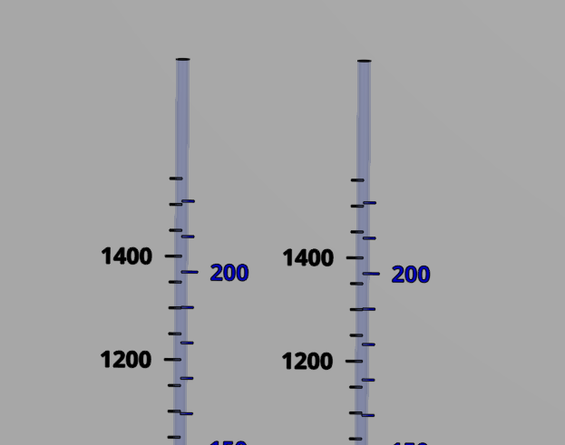
Coagulant
Chlorine
Stock tank
(L)
Calibration column
(mL)
Stock tank
(L)
Calibration column
(mL)

Slide 2
1
2
3
4
5
6
7
8
Notes:
First plants didn’t include filters
Or floc filters
Got the water clean enough so that chlorination could be effective

Slide 3
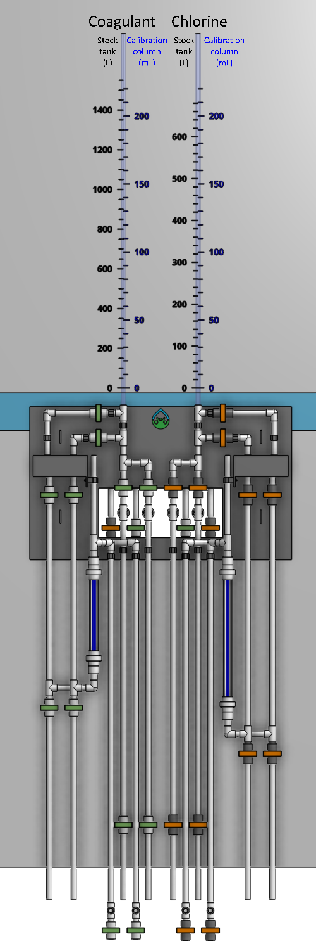
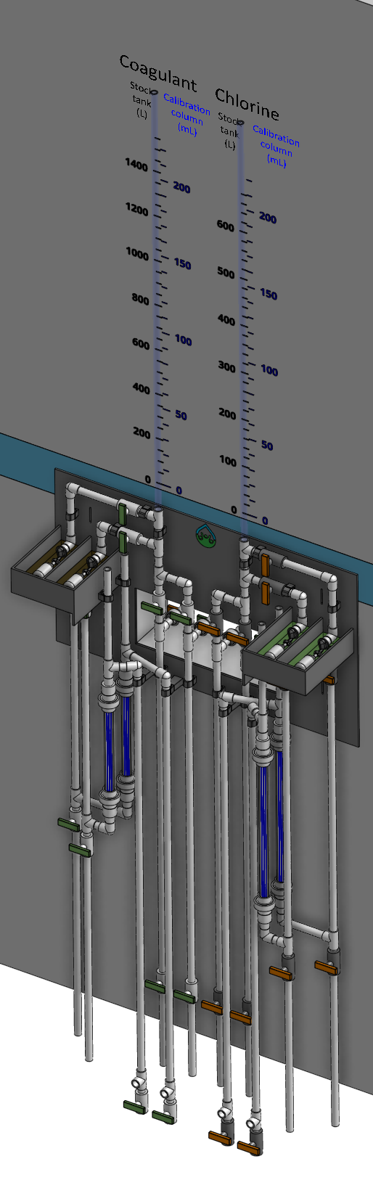
1
2
3

Slide 4
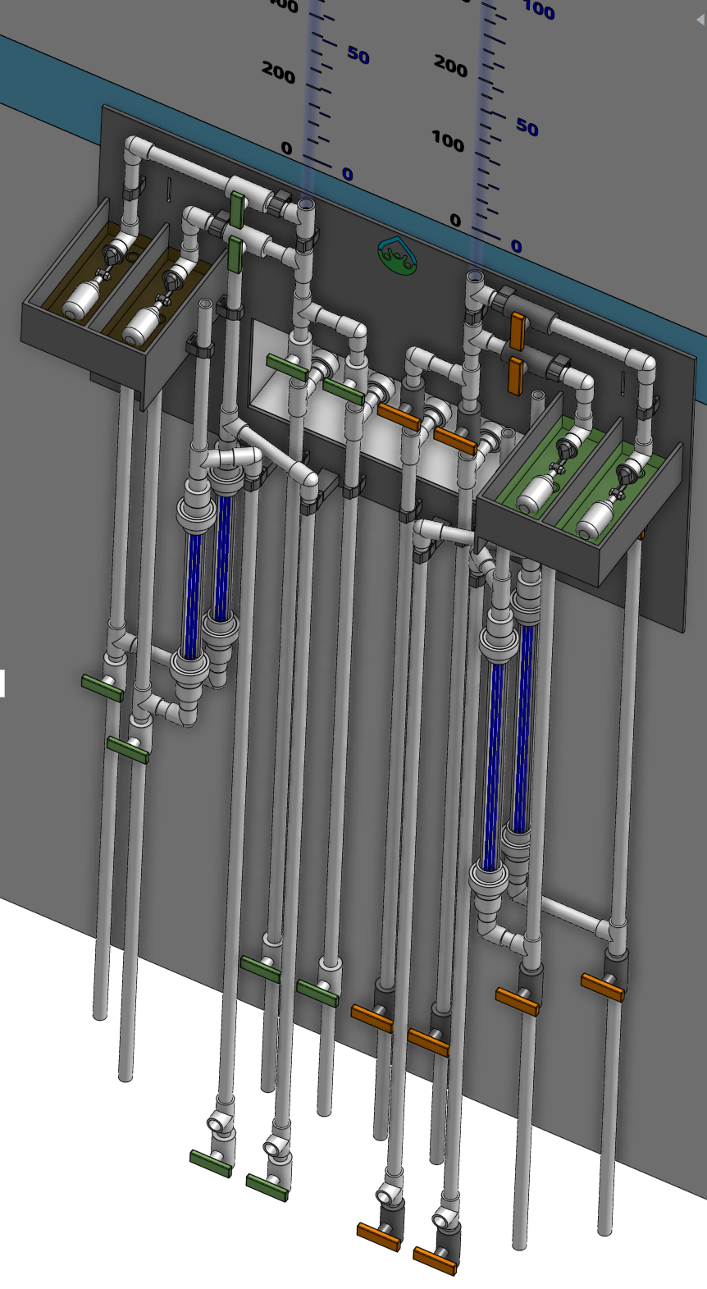
1
2
3
4
5
6
7
8
9
10
11
12

Slide 5
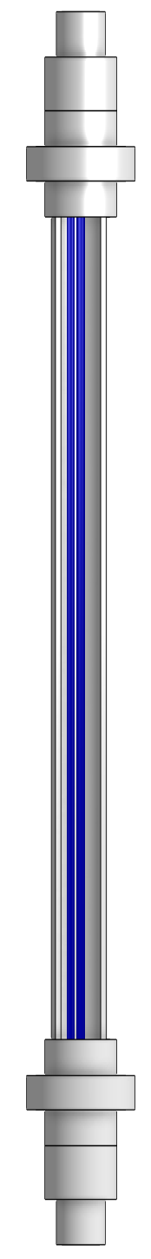
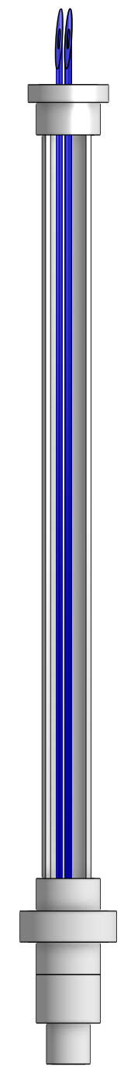
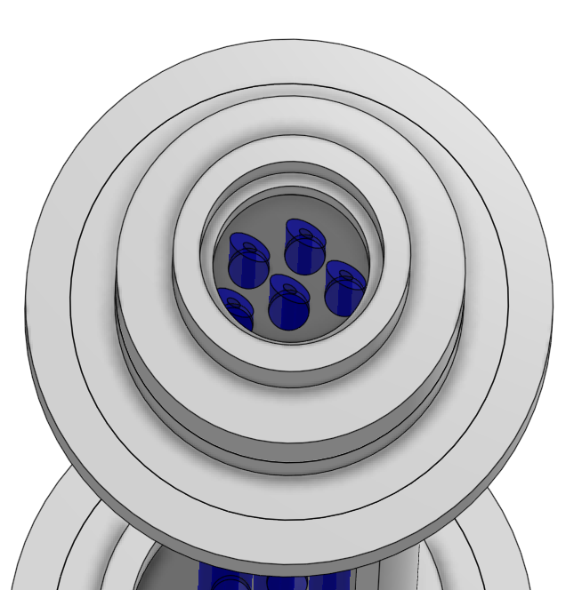
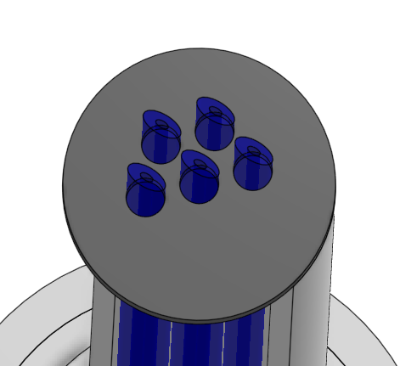
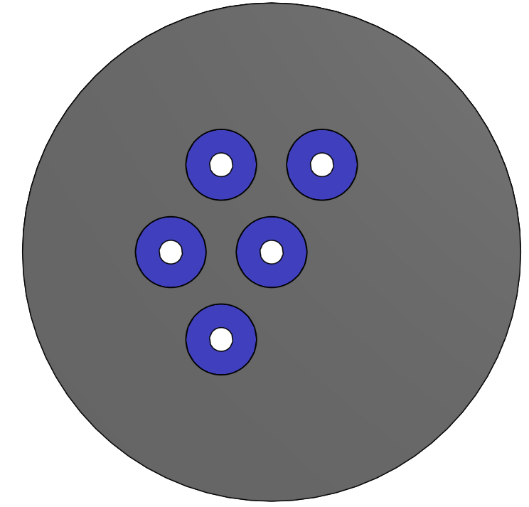
1
2
6
7
3
4
6
5
6
4

Slide 6
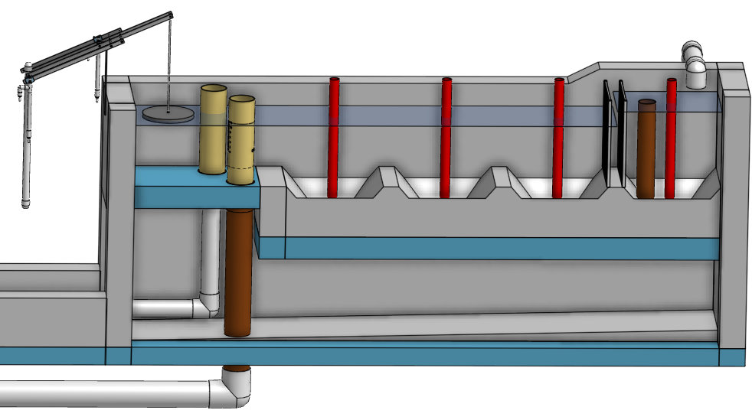
1
10
3
5
6
8
2
4
9
11
7
12
13

Slide 7
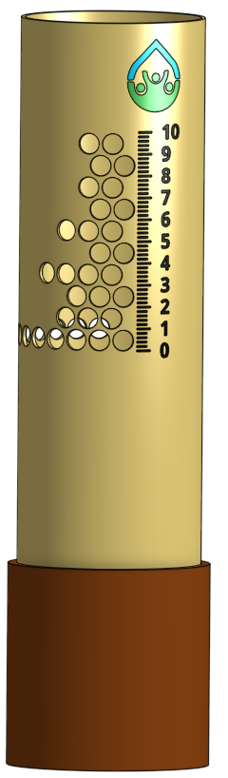
1
2
3
4
5

Slide 8
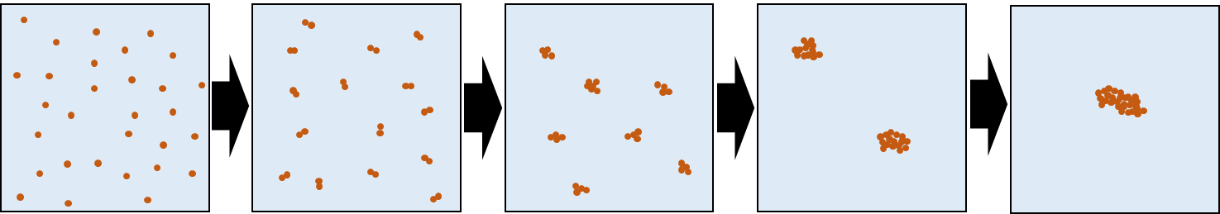

Slide 9
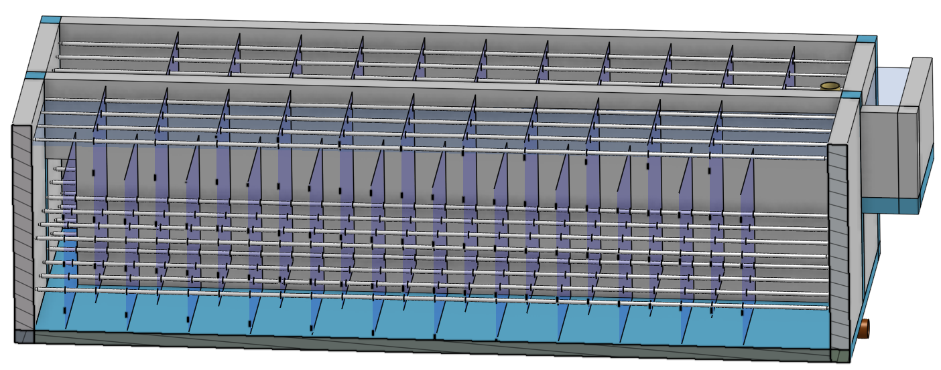
6
7
1
2
3
4
5

Slide 10
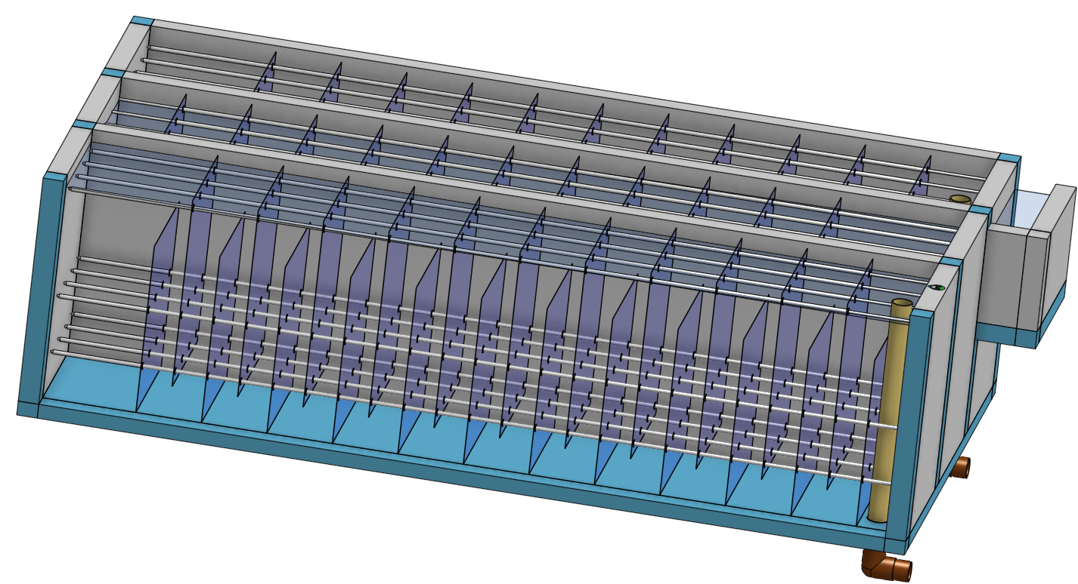
Not used
8
7
6
9
5
1
2
3
4

Slide 11
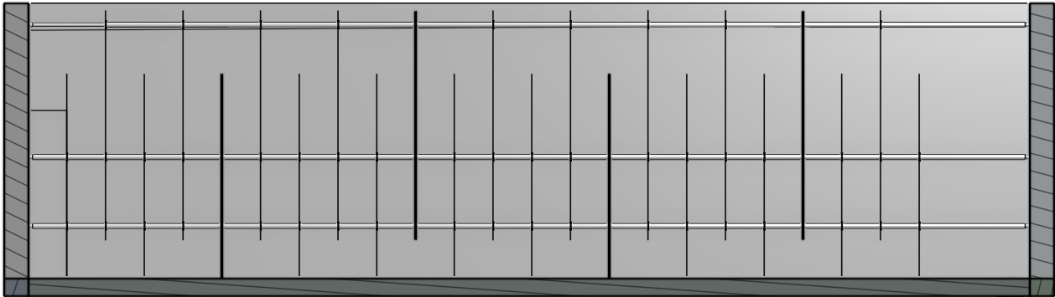
Not used
1

Slide 12
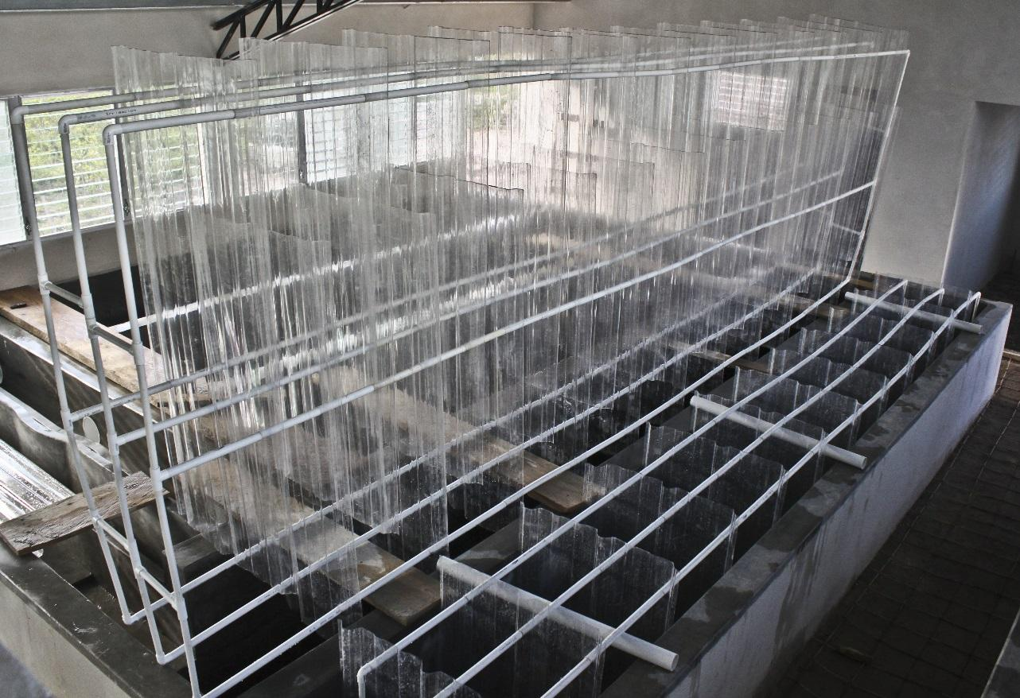
1
2
3

Slide 13
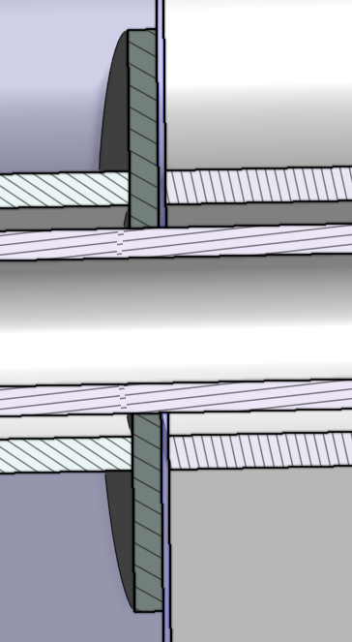
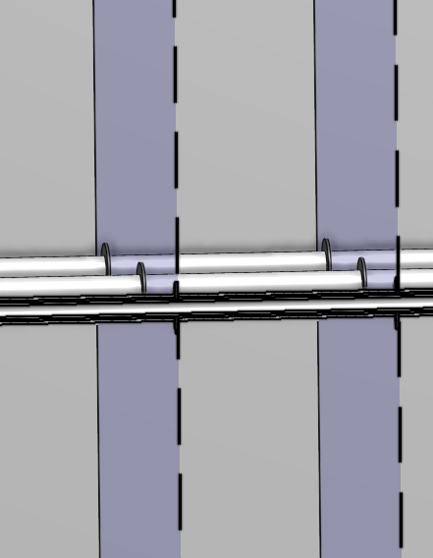
1
2
3
4

